Slide 1
Service Animals in STVRs

Slide 2
ARE SERVICE DOGS PETS?

Slide 3
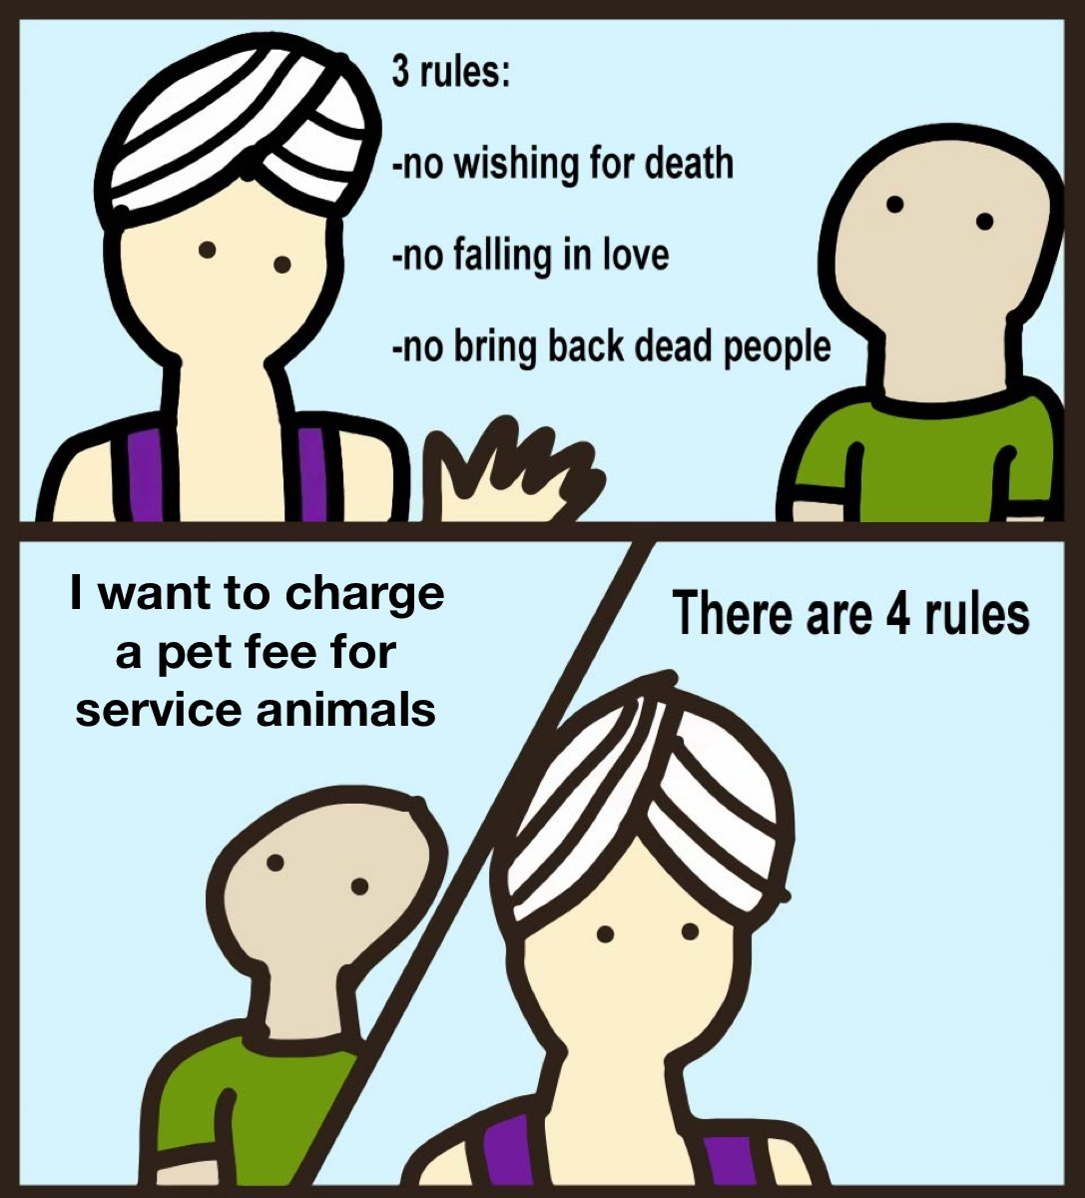
"Can I charge a pet fee?"

Slide 4
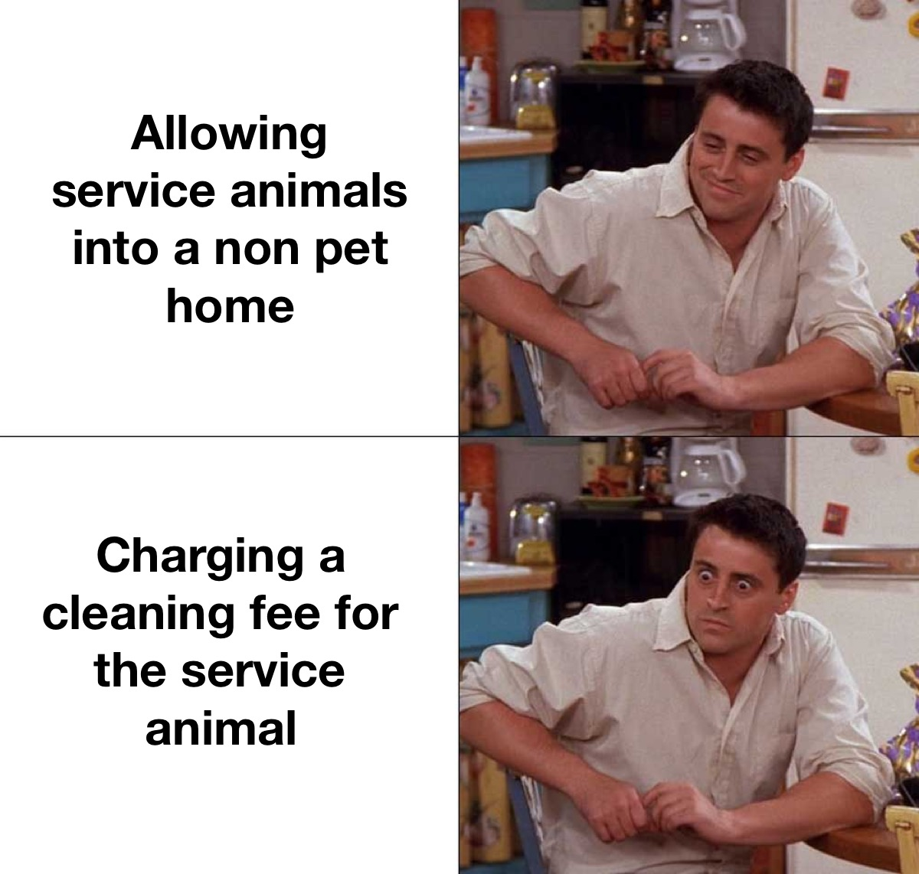
"What about cleaning fees?"

Slide 5
Image credit: https://www.pinterest.fr/pin/123778689736917733/

Slide 6
Define your terms
What is a service animal? (ADA)
What is a service animal in training?
What is an ES/PS animal?
What is a therapy animal?

Slide 7
Service Animal Definition
Under the ADA, a service animal is defined as a dog that has been individually trained to do work or perform tasks for an individual with a disability. The task(s) performed by the dog must be directly related to the person's disability.
Source: https://www.ada.gov/regs2010/service_animal_qa.html

Slide 8
What questions can I ask about service animals?
1. Is the dog a service animal required because of a disability?
2. What work or task has the dog been trained to perform?

Slide 9
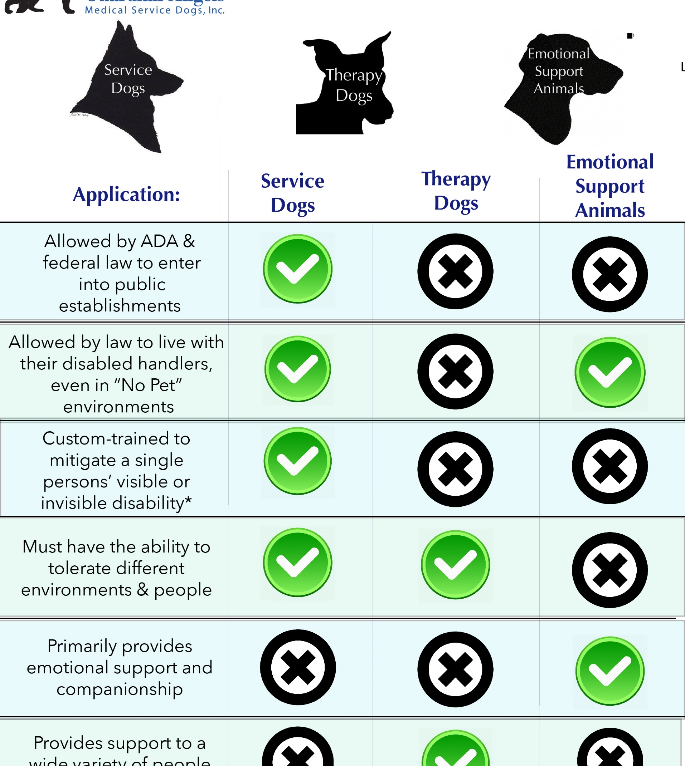
Differences in
Service
Therapy
ES/PS
Image Credit: medicalservicedogs.org

Slide 10
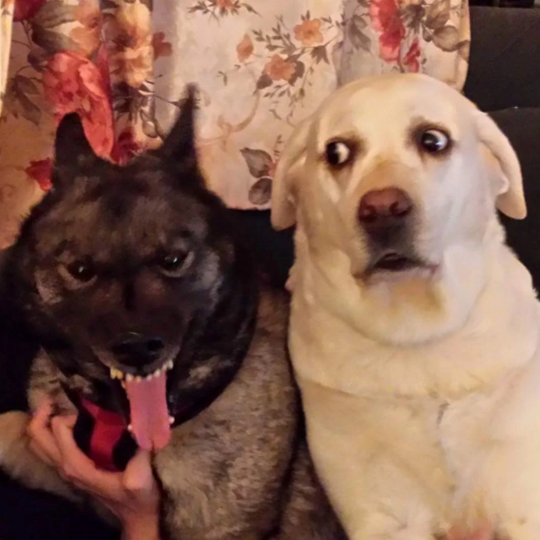
Be specific about animal behavior

