Slide 3
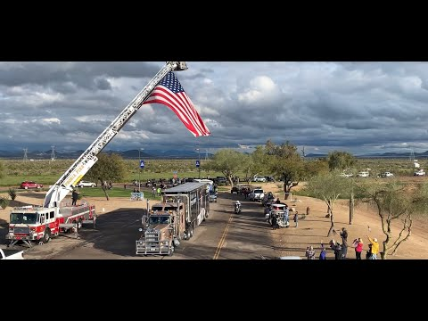
A VIDEO OVERVIEW

