Slide 1
NAR Seller Class Action Litigation Overview
August 2023

Slide 2
Litigation update
Impact: What does this mean for businesses, consumers, brokerages and MLSs?
What can I do?
Contents
Notes:
As the October trial approaches, I want to give you an overview of the latest on the seller class action lawsuits, the impact they could have, and what you can do to help tell our story and win in the court of public opinion.

Slide 3
Litigation Background
Notes:
Let’s start with a litigation background…

Slide 4
What’s Going On?
NAR and 4 corporate (brokerage) defendants were sued in lawsuits filed in Missouri (plaintiff “Burnett”) and Illinois (plaintiff “Moehrl”) alleging commission rates are too high, buyer brokers are being paid too much, and NAR’s Code of Conduct and MLS Handbook along with the corporate defendants’ practices lead to price fixing.
NAR and the corporate defendants adamantly disagree, and NAR’s rules are very intentionally pro-consumer and pro-competitive.
While the Moehrl case is in earlier stages, Burnett is scheduled to go to trial in October 2023.
Notes:
In the litigation landscape that the National Association of REALTORS® is facing today, much of what NAR is fighting is misinformation, mischaracterization and lack of understanding or education.
There are class-action attorneys and other challengers who have a blatant disregard or lack of appreciation for the value REALTORS® bring consumers and how local MLS broker marketplaces serve the best interests of American home buyers and sellers.
So here’s what these lawsuits are about [see slide].

Slide 5
What is NAR Doing to Prepare Legally?
NAR has the very best inside and outside legal teams in place to defend these very pro-consumer, pro-competitive rules and practices in local MLS broker marketplaces.
Our legal experts are confident we will ultimately prevail in each case because we act in the best interests of consumers, and the law and facts are on our side.
Notes:
Litigation is a long, complex process that will not be resolved for years, and NAR takes each case and legal development seriously.
NAR leadership is taking proactive measures to ensure consumers continue to benefit from the access and opportunities they have today and that real estate professionals continue to be equipped and positioned to serve the best interests of those consumers.

Slide 6
What Are The Key Points We Are Making?
We fundamentally disagree with how class action attorneys are characterizing our rules. At the heart of all this is that very much because of NAR’s rules and how well local MLS broker marketplaces function, consumers are better off and competition is able to thrive.
The very reason NAR exists is because there was a need 100 years ago for a higher level of ethical practice in real estate – that’s where NAR came in. We want to make it very clear that:
REALTORS® look out for their clients above all else;
Compensation is set between brokers and their clients and is negotiable;
The free market and competition are encouraged by NAR; and
There’s incredible value in using a real estate agent, especially a REALTOR®, when you buy or sell your home.
In fact, Article 1 of the NAR Code of Ethics requires a REALTOR® to “protect and promote the interests of the client.” NAR has a rule that negotiations are allowed at any time. NAR has rules that prohibit anti-trust behavior.
Notes:
NAR needs your help to educate consumers about:
How local MLS broker marketplaces work and promote equity, transparency and market-driven pricing options for consumers
The incredible value you as REALTORS® provide.

Slide 7
What Is NAR Doing to Address Confusion in The Marketplace?
There is misinformation and lack of understanding about NAR, how local MLS broker marketplaces work and the value of REALTORS®, particularly by class action attorneys.
NAR is regularly letting the media and people across real estate, academic, civic and business communities know how NAR, local MLS broker marketplaces and REALTORS® serve the best interests of American home buyers and sellers.
Notes:
At the end of the day, we all know that REALTORS® are consumers’ advocates.
We all know that REALTORS® lead as entrepreneurs, small business owners, experts and philanthropists to protect consumers, build generational wealth and contribute to local and national economies.
And we also know local MLS broker marketplaces create the largest, most efficient and convenient markets that ensure equity, transparency and market-driven pricing for home buyers and sellers.​​​​​
It is imperative that right now, REALTORS® do all they can to communicate that reality every day in all the conversations they have and channels at their disposal. While NAR’s legal team is helping the association win in a court of law, the association asks members to play their part to help win in the court of public opinion.

Slide 8
What Are Possible Outcomes From The Trial?
The optimal scenario is an immediate win in the trial. Otherwise, one outcome is a monetary damage award against the defendants. Or there could be a court order changing NAR’s policies or how commissions are paid to brokers.
It is highly likely that no matter which side prevails at trial, the losing side will appeal. That means a definitive ruling is not imminent. It will be several years before we reach a conclusion.
Notes:
Of course, legally, the optimal scenario is an immediate win in the trial. If the plaintiffs prevail, there could be a number of different outcomes.
One outcome is a monetary damage award against the defendants. Or there could be a court order changing NAR’s policies or how commissions are paid to brokers.
It is highly likely that no matter which side prevails at trial, the losing side will appeal.
That means a definitive ruling is not imminent. It will be several years before we reach a conclusion.

Slide 9
What Is NAR Doing to Prepare for Different Outcomes?
Sellers already sign contracts agreeing to what they will pay in commission to the sellers’ agent. We also are continuing to encourage REALTORS® to use buyer broker agreements and be reminded of their obligations under the Code of Ethics to advise their clients and make all agreements in writing and clear and understandable.
Just as NAR has been doing for years, it’s also an imperative that REALTORS® continue to express that commissions are set between brokers and their clients, how much competition there is and REALTOR® value, at every chance they get. And remind consumers all the ways REALTORS® help them navigate the legal, community and financial aspects of buying and selling a home.
Notes:
Despite how long a final outcome may take, it doesn’t mean we can sit back and wait.
In addition to correcting the misinformation spread by plaintiffs’ attorneys, NAR is taking steps to prepare for a range of outcomes and there are two main things we can do to support:
Use buyer representation agreements.
Tell our story about how commissions are set, how competitive the market for real estate services is and the value of working with a REALTOR®.

Slide 10
How Does the July 2023 MLS PIN Settlement in Massachusetts Affect NAR’s Case?
Not at all.
NAR is not part of that lawsuit, nor do we expect it to notably affect our compensation litigation. We remain confident our rules are legal and pro-consumer.
Also worth noting is that MLS PIN admitted no wrongdoing, and the settlement does not definitively address the practice of listing brokers making offers of compensation to buyer brokers. In litigation against NAR, we are seeking outcomes that will protect this pro-consumer, pro-competitive practice and all members.
Notes:
Some of you may have seen articles about a similar lawsuit, Nosalek v. MLS Property Information Network, and that MLS PIN recently settled that lawsuit.
If you’re wondering how that affects the Burnett and Moehrl cases, the answer is: it doesn’t [see slide].

Slide 11
Impact: What does this mean for…consumers, brokerages and MLSs?
Notes:
As I said earlier, the ultimate outcome is likely still years away, but let’s look at how this impacts consumers, brokerages and local MLS broker marketplaces

Slide 12
What Does All This Mean for Consumers?
If NAR could not adopt pro-consumer rules that ensure client interests are primary and that make buying and selling real estate smoother, we would be forced back into the 19th Century “wild west” where unscrupulous people could regularly defraud clients.
If local MLS broker marketplaces didn’t work the way they do now, there would be no centralized source of available homes. Buyers would have to visit every broker in town to see all available homes. There would be outdated home status information. There would be fewer homes for buyers to choose from on real estate sites.
We could expect over time for property information to become unverified, inaccurate and unreliable. Sellers would likely have to pay to list and advertise their properties on websites. Buyers unable to afford a buyer broker would have fewer options.
Notes:
Our rules are pro-consumer, so eliminating them could lead to a range of negative consumer impacts, including:
Weakened consumer protections
Erosion of equal access to listings
Decreased efficiency in buying and selling their homes
The inability to afford representation as a buyer
And more

Slide 13
How Does This Litigation Affect Brokerages and MLSs?
NAR’s mission is “to empower REALTORS® as they preserve, protect and advance the right to real property for all.” And our vision is “to be a trusted ally, guiding our members and those they serve through the ever-evolving real estate landscape.”
NAR rules enable local MLS broker marketplaces to operate in a way that brokerages of all sizes – especially and including small business brokerages of which the vast majority of REALTORS® are – can participate, compete with each other and flourish.
NAR is working to help others avoid the incredible cost, risk and time that comes with standing up for these pro-consumer rules and ways of doing business. NAR will always stand up for those things – we are the proxy for home sellers and buyers and pro-consumer ethics, rules and practices.
We have a strong story to tell about how our rules for affiliated local MLS broker marketplaces serve consumer interests and competition and that the misinformation in the market has confused home buyers and sellers.
Notes:
As far as impacts for you and your businesses, removing pro-competitive rules would be worse for all of us.
Changing NAR’s rules would go against NAR’s mission of empowering you to best serve your clients because NAR’s rules do just that.
MLSs could see a range of negative impacts too, from fewer listings and buyers interested in those listings to fewer particpants.
That’s why NAR is working to defend against these lawsuits, so you can stay focused on serving your clients.

Slide 14
What Can I Do?
Notes:
So what can you do to help?

Slide 15
What Can I Do?
Each of us has a role to play in educating people about how local MLS broker marketplaces provide market-driven pricing and opportunity for consumers and level the business playing field. Each of us have important stories to tell about the value of REALTORS®. Every chance you get – in conversations, on your website, in the community – share that. And share materials from competition.realtor far and wide.
Also, in addition to the longstanding practice of having listing agreements, every real estate agent can and should use buyer broker agreements. Also continue to remind yourself of your obligations under the NAR Code of Ethics to advise your clients and make all agreements in writing and clear and understandable.
Notes:
There is so much to say about who REALTORS® are, what you do and how you work that can capture the hearts and minds of consumers and those who care about the real estate industry.
Having served as [position] for [years], I see and hear so many good things about our pro-consumer, pro-competitive ways of doing business:
Stories telling how small business owners can compete because local MLS broker marketplaces level the playing field.
Stories of first-generation home buyers who are able to both afford a home and have a REALTOR® represent them because of how real estate works today.
Stories of REALTORS® who, by day, help people figure out the financial, legal and community aspects of buying a home but, by night, volunteer in their community and help to make it a better place to live.

Slide 16
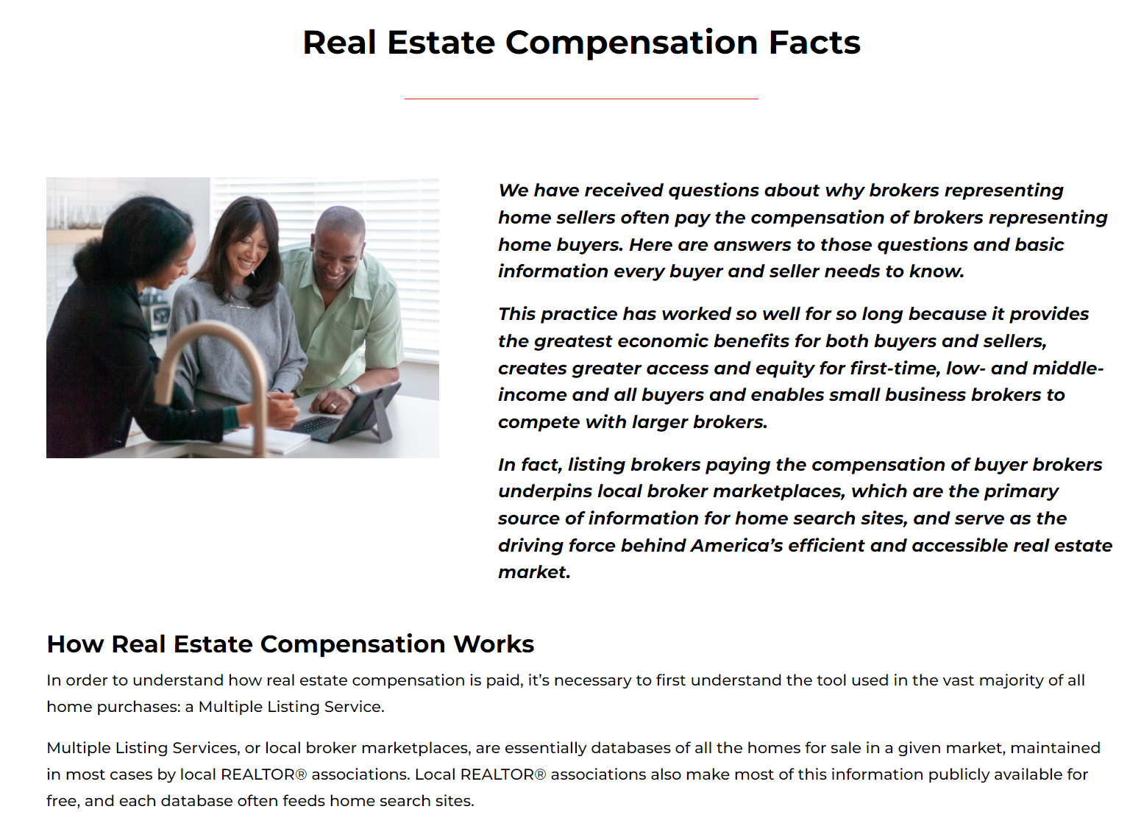
What Are Resources For People to Get More Information?
NAR developed the website competition.realtor that hosts key points, FAQs, articles and infographics regarding how local MLS broker marketplaces enable consumer access and opportunity and foster competition as well as how REALTORS® are consumer champions.
There is also realestatecommissionfacts.com to aid consumers’ understanding of broker services and how real estate professionals are compensated.
Notes:
Lastly, and to jumpstart you in telling your stories, let’s look at some resources available to you.
This site is a place to send people who have questions, and it’s a resource for you to pull things you need to be ambassadors with clients and others in your community.
The site hosts fact sheets, FAQs, articles, infographics and other information you can use that:
Illustrate how REALTORS® are consumer champions.
Describe how local MLS broker marketplaces create highly competitive markets that promote equity, greater access, more choices and greater pricing options when it comes to real estate services.
Provide soundbite updates on NAR policy changes and legal matters.
In addition, NAR has created a simple consumer website at realestatecommissionfacts.com to aid consumers’ understanding of broker services and how real estate professionals are compensated.

